Slide 1
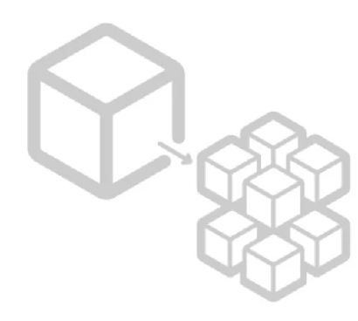
Microservices
Part 2 : Eureka Server

Slide 2
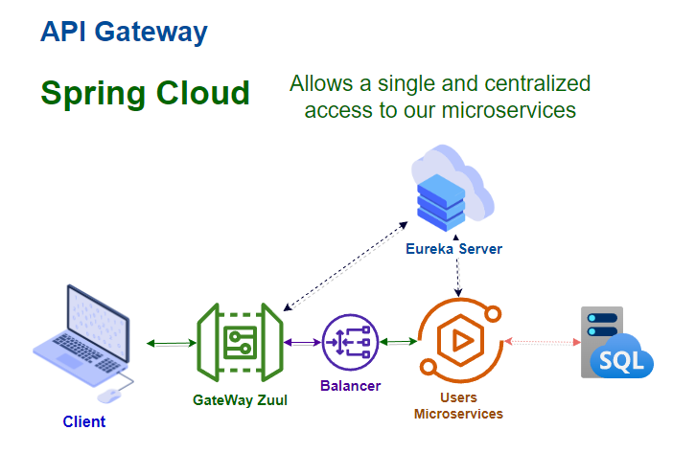
Architecture

Slide 3

Discussion:
Why Eureka in our microservice?

Slide 4
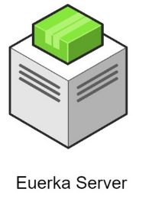
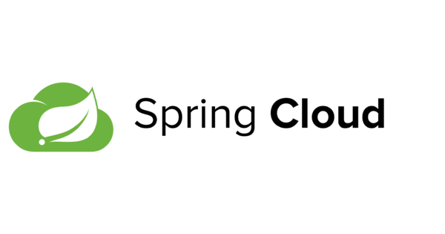
Eureka Server
Eureka Server is an application that holds the information about all client-service applications. Every Microservice will register into the Eureka server and Eureka server knows all the client applications running on each port and IP address.
Eureka Server comes with the bundle of Spring Cloud. For this, we need to develop the Eureka server and run it on the default port 8761.

Slide 5
Eureka Server
It is a server for name records
Is like a "container" for microservices
Requires an identifier for each service
Each microservice must be a Eureka client for self-discovery
Registers the meta-data of the microservices
Allows decoupling of IP and Port.
Allows communication by name and identifier

Slide 6
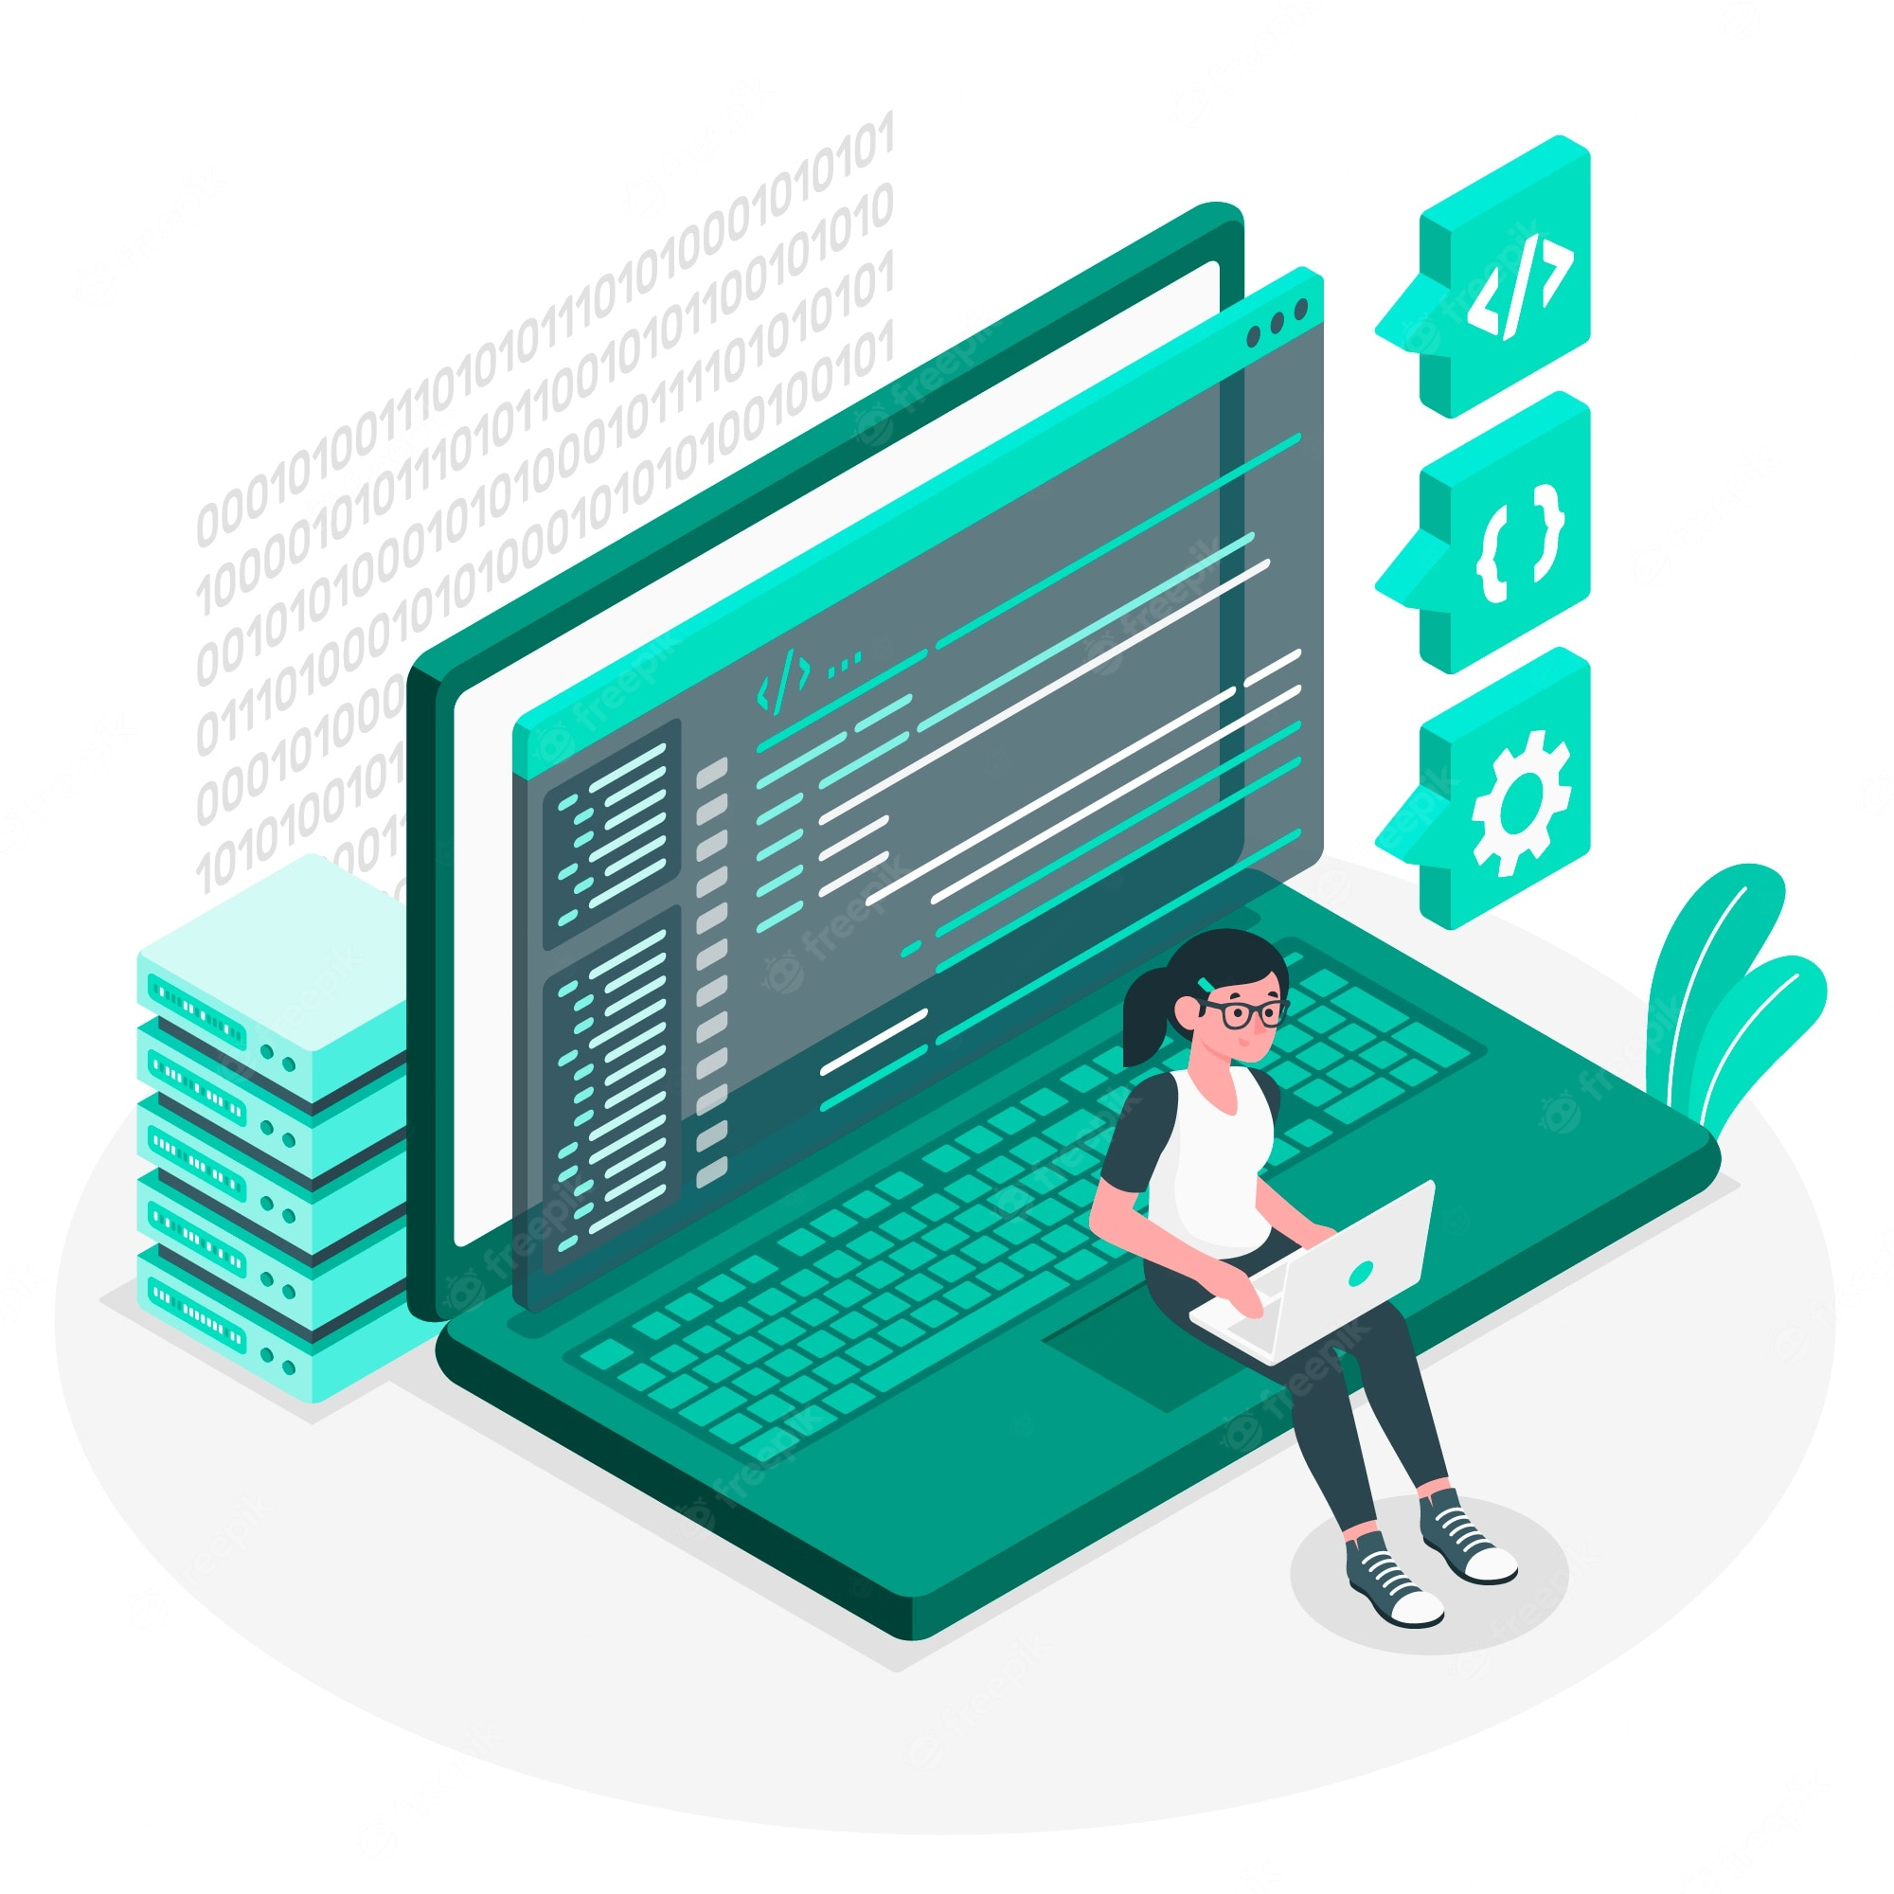
Let’s code and implement our server

Slide 7
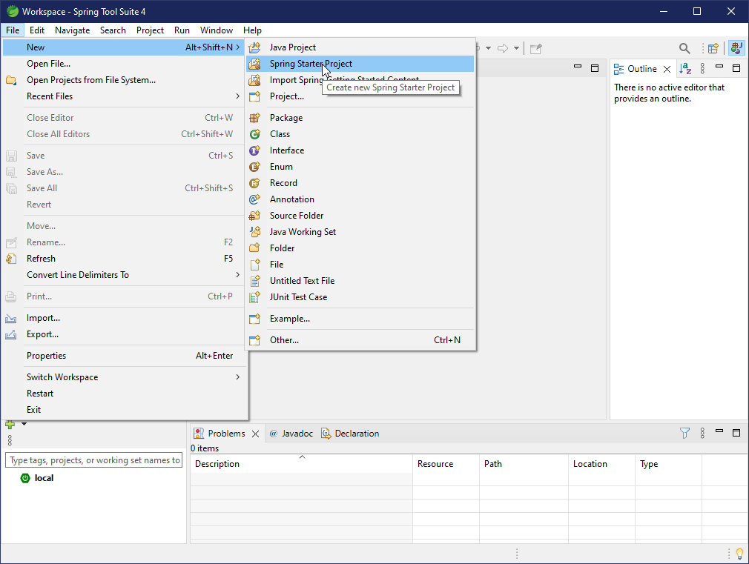
Creating the Eureka Server

Slide 8
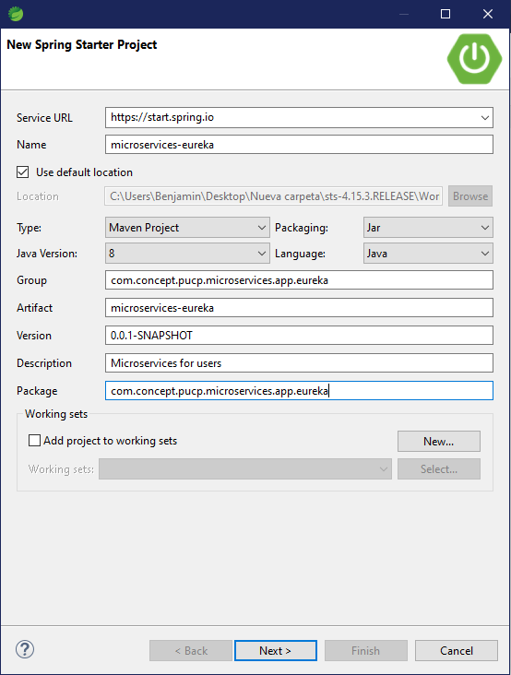
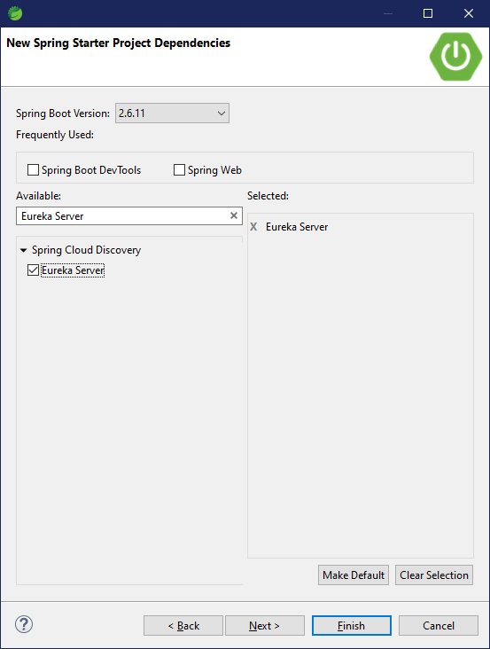
Creating the Eureka Server

Slide 9
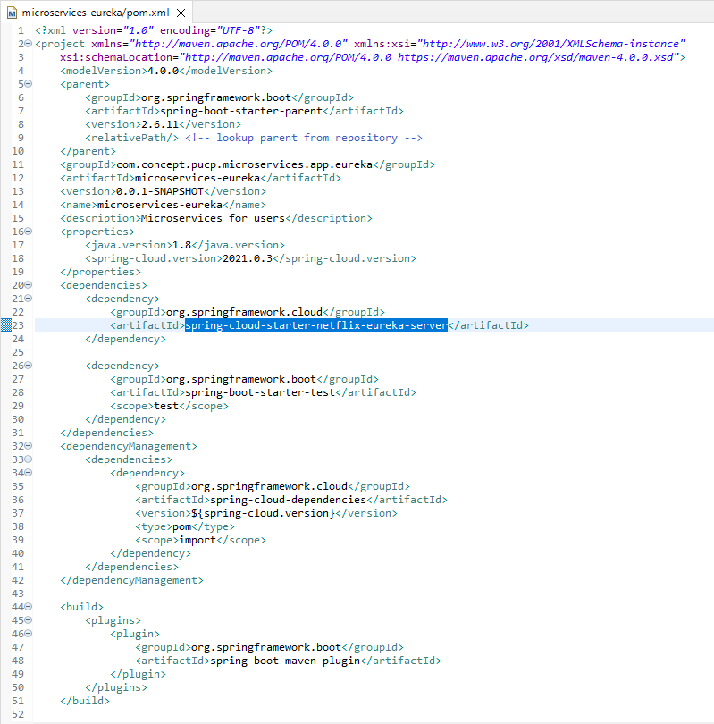
Reviewing our Pom.xml

Slide 10
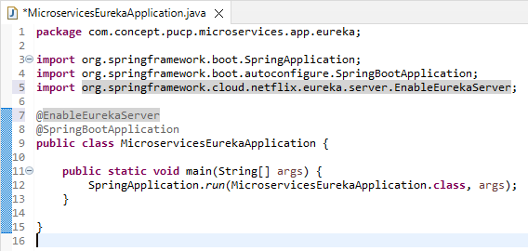
Enabling our Eureka server

Slide 11
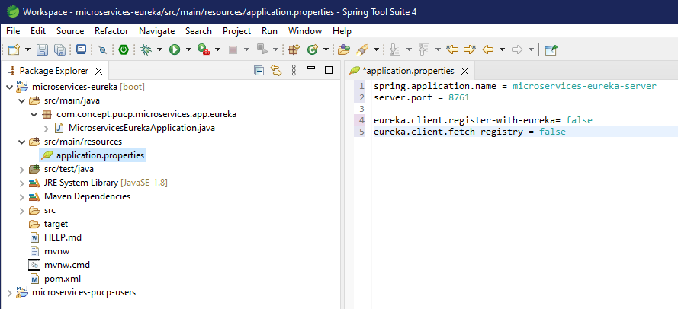
Editing our properties file

Slide 12
Connecting the User service to Eureka

Slide 13
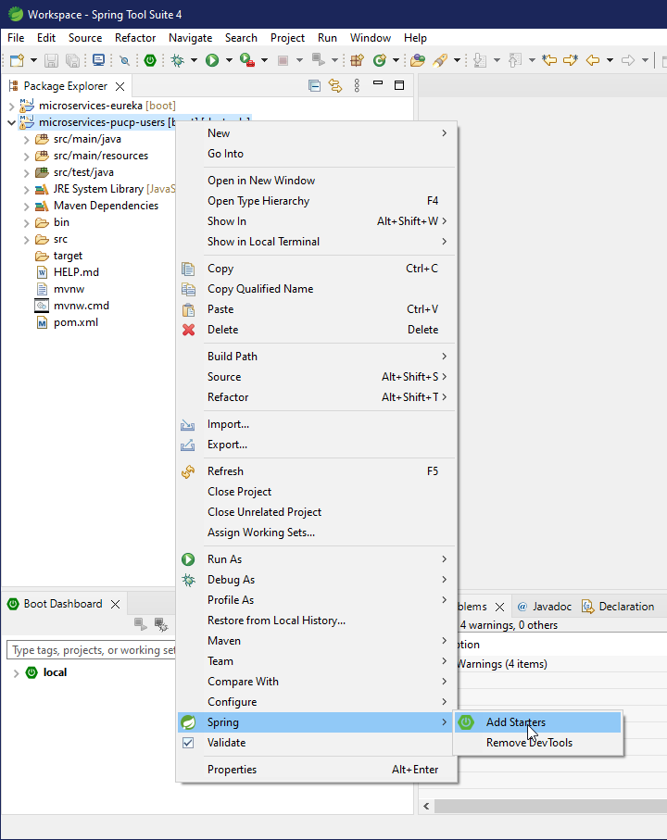
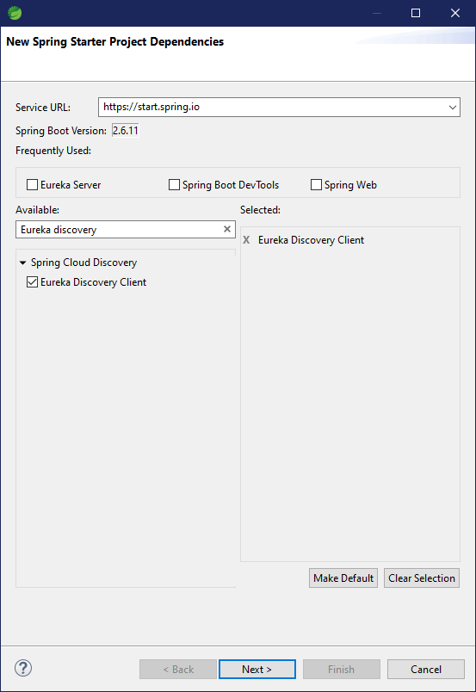
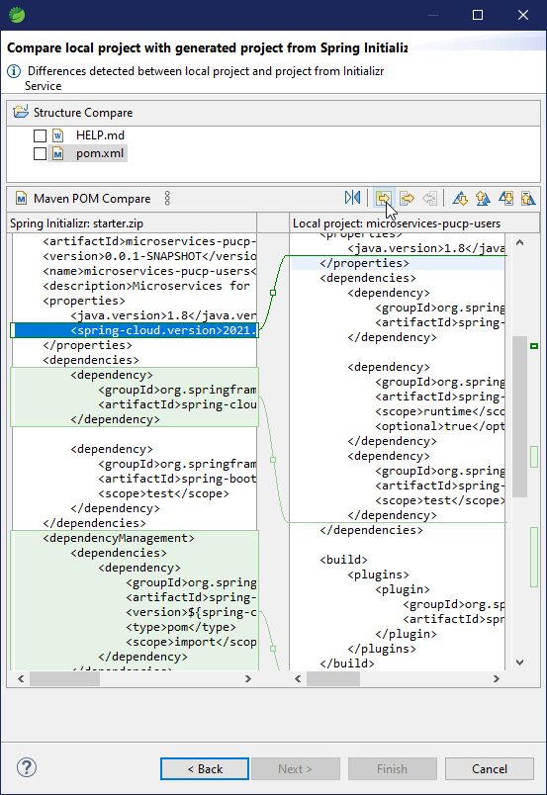
Connecting the User service to Eureka

Slide 14
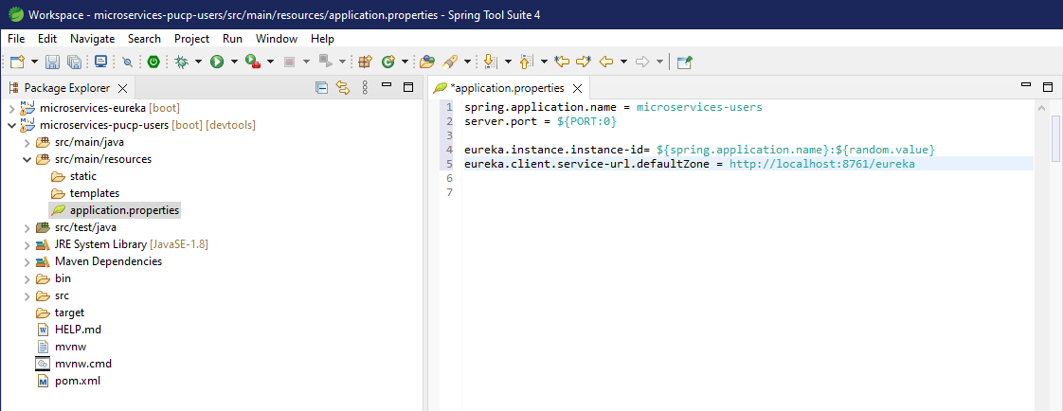
Connecting the User service to Eureka
Configuration in the application.properties file :
Assign an application name in Spring.
PORT:0 is set, so that the application itself assigns an available port.
Set an id of an instance of eureka, use a random to make it unique
Specify the URL of the Eureka server

Slide 15
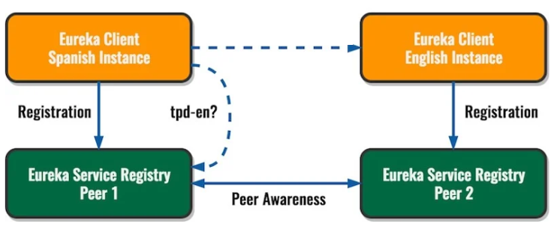
Eureka Peer Awareness (/Eureka)
It let us to have two registry instances that can share with each other the contents of the registry (the registered clients) so they can implement resiliency and those clients can find each other contacting the instance that they know.
The Replica mode will NOT work if you use the same hostname in both instances. That means that you need to give your host two different aliases.
The Replica mode will NOT work if you use different application names in both instances. It makes sense since the application itself is the same, it's just that we're replicating it.
The magic behind the Replica mode is as simple as configuring each instance to register in another one. You can extend this to as many instances as you like, as long as you keep connecting all the edges
Since in our project we are not having any replicas, The Eureka server is pointing to the registered-replicas at http://localhost:8761/eureka/ but marking it as unavailable , for that reason we are going to use http://localhost:8761 to enter to our server.

Slide 16
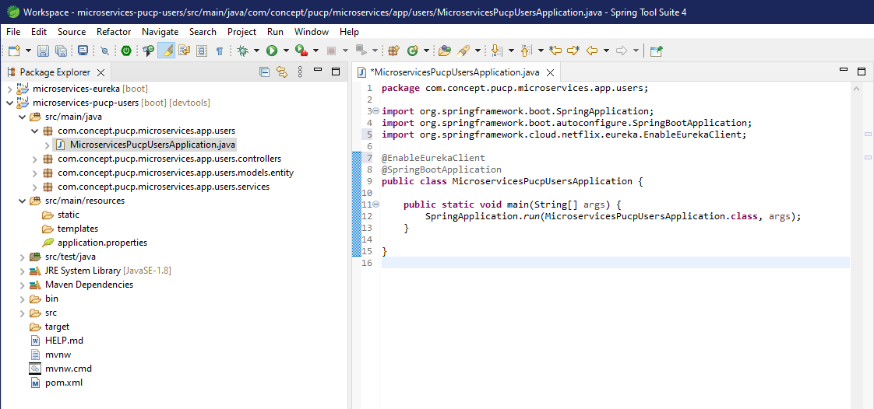
Connecting the User service to Eureka
The @EnableEurekaClient notation is added.

Slide 17
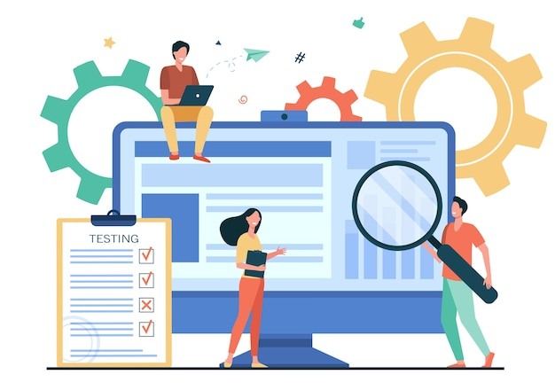
Testing our services

Slide 18
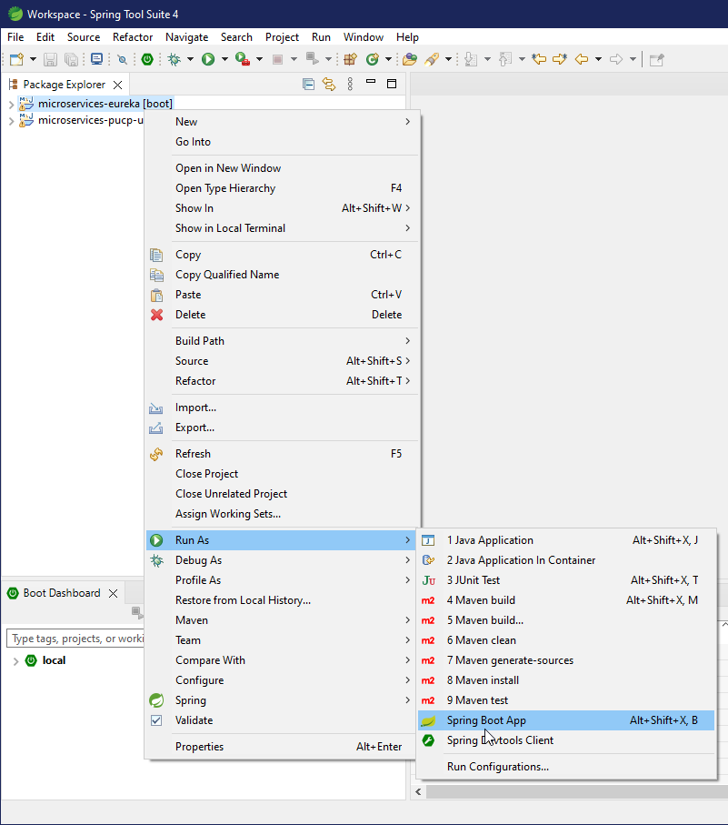
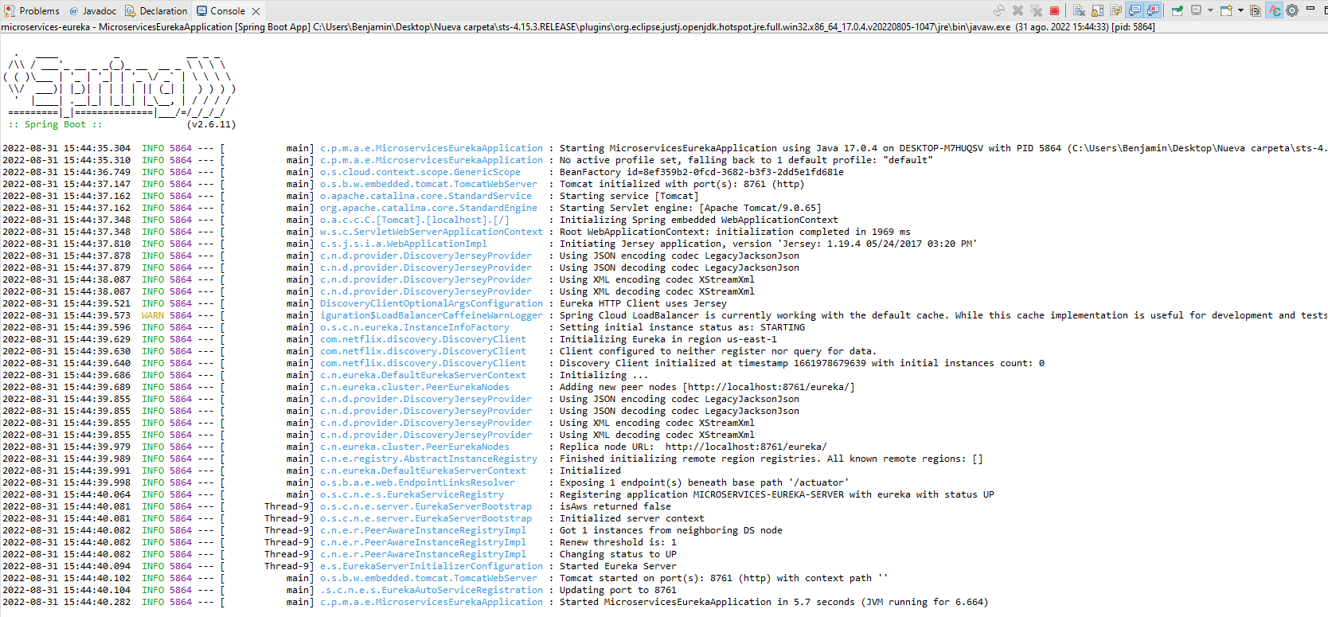
Testing our Services
In the Eureka project, select: Run As / Spring Boot App

Slide 19
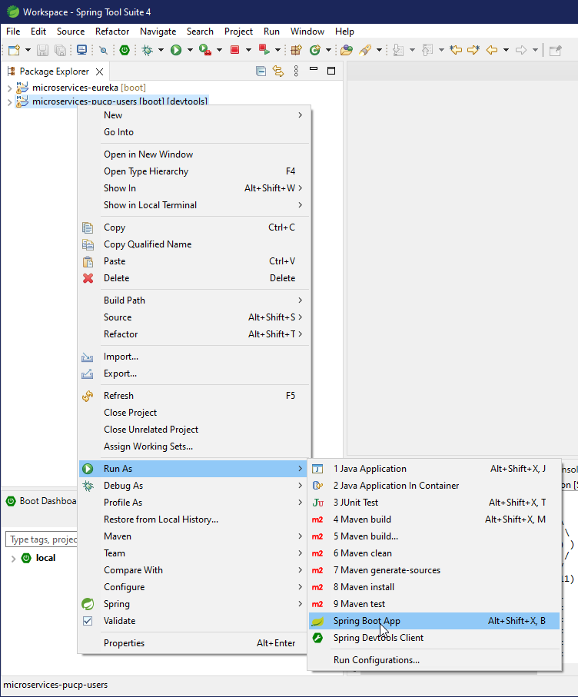
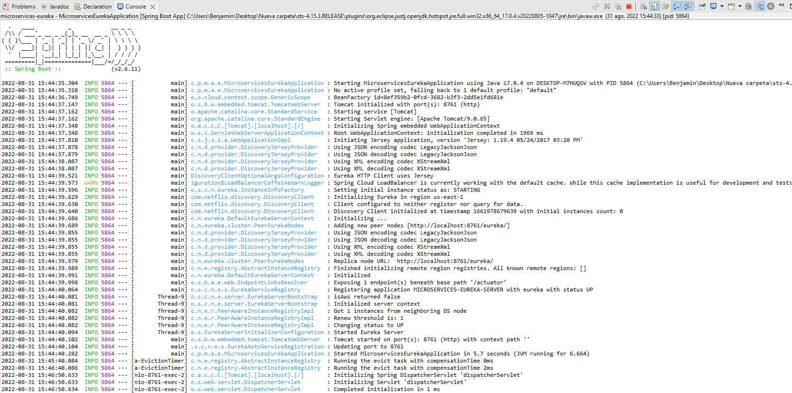
Testing our Services
In the User Microservice project, select: Run As / Spring Boot App

Slide 20
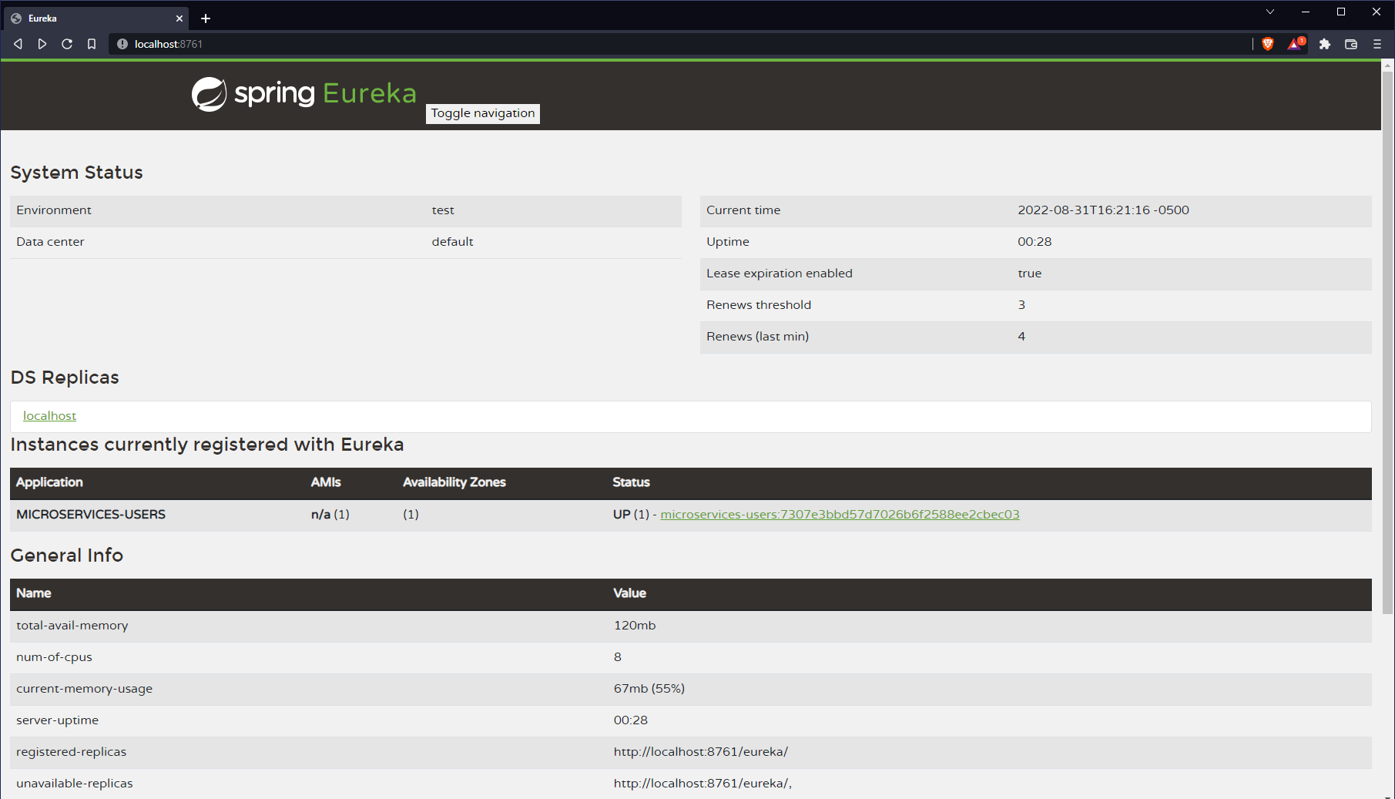
Testing our Services (Http://localhost:8761)

Slide 21
Adding Instances
In the User Microservice project, select: Run As / Spring Boot App

Slide 22
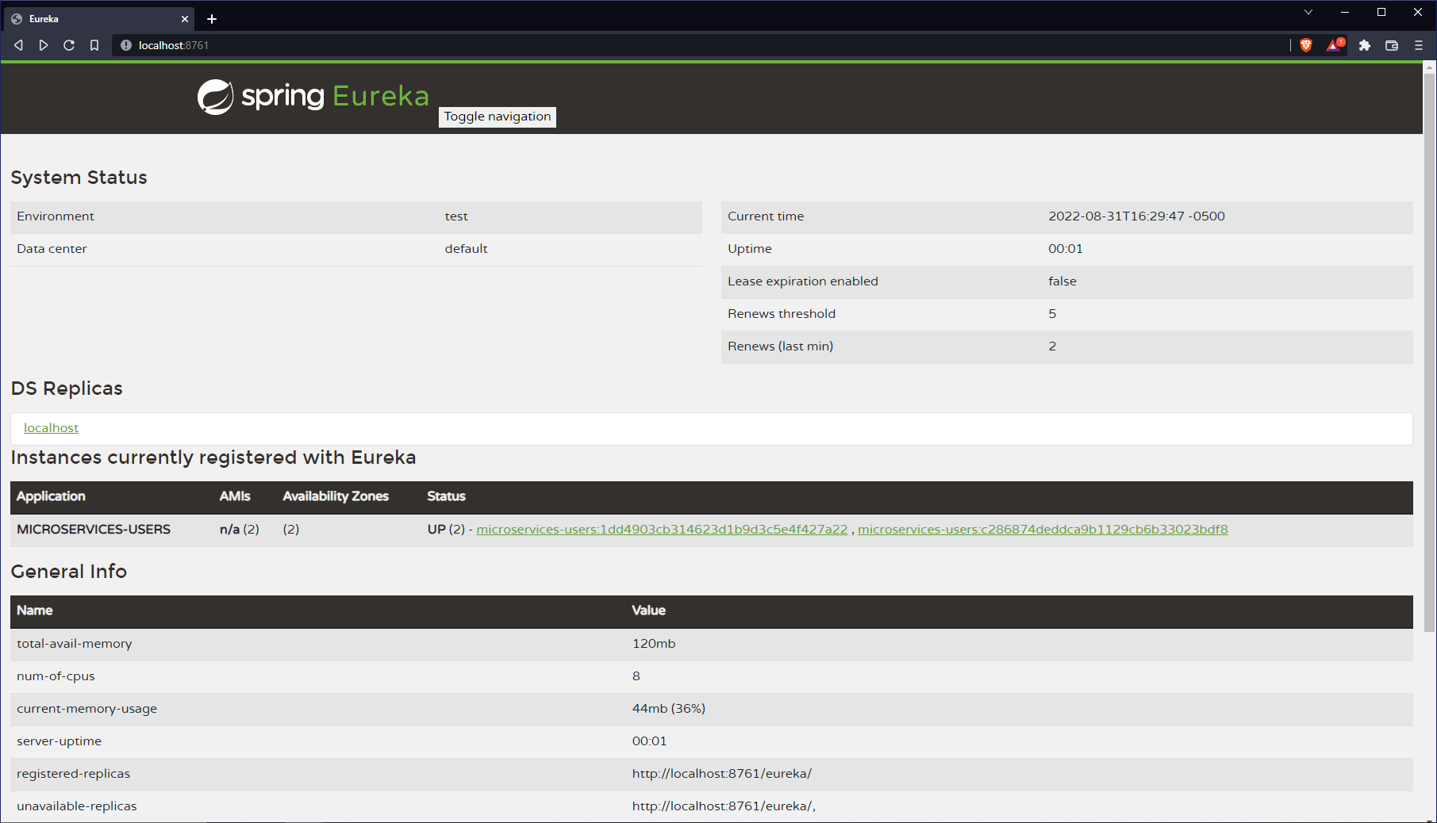
Adding Instances

